Slide 1
CSE 601: Distributed Systems
Toukir Ahammed

Slide 2
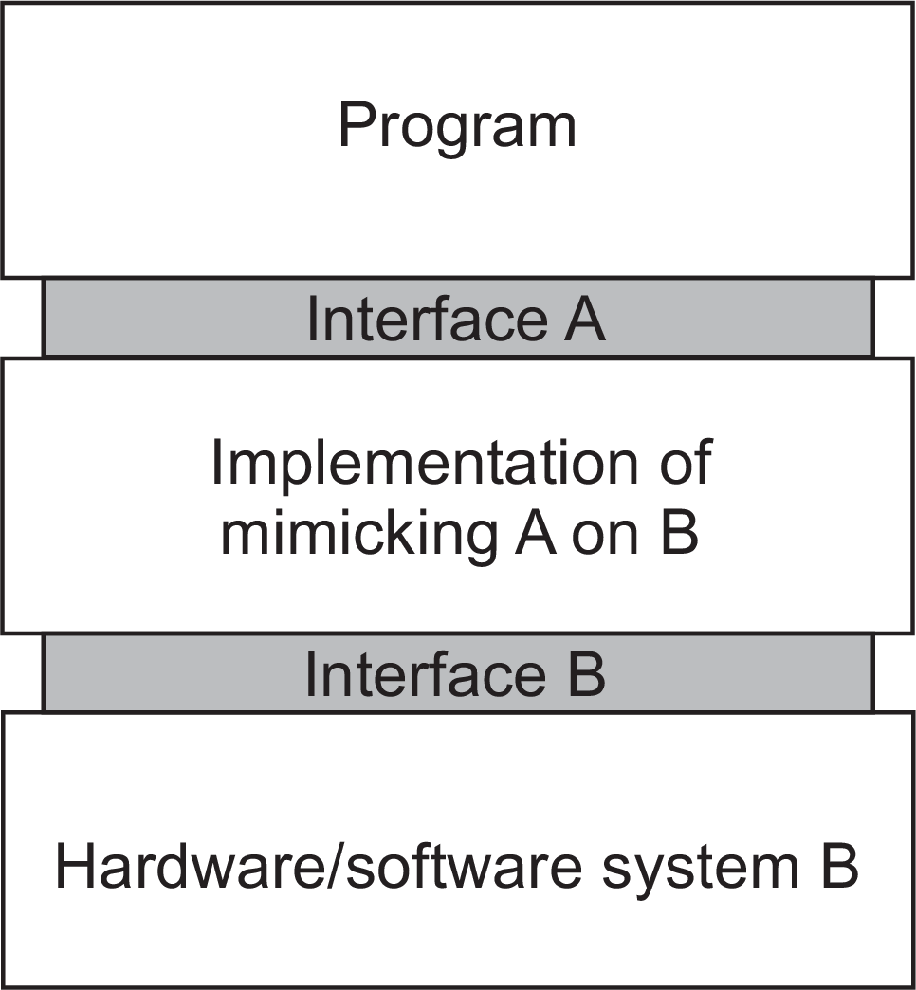
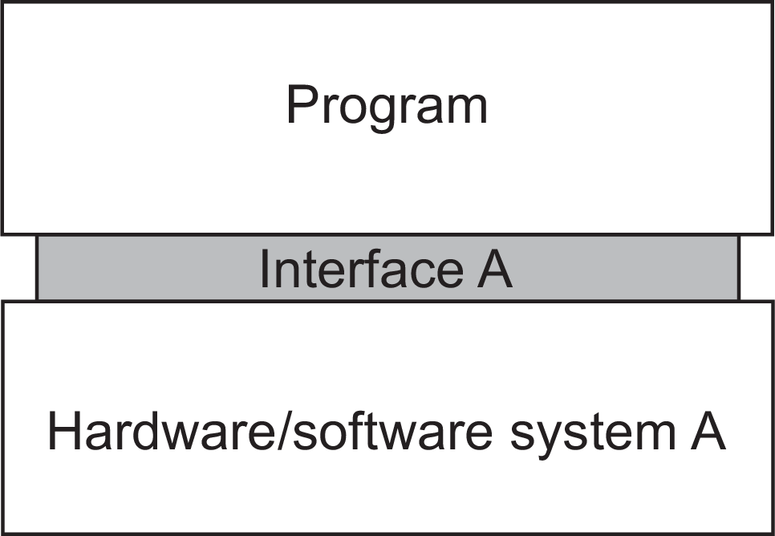
Virtualization
Virtualization deals with extending or replacing an existing interface so as to mimic the behavior of another system,

Slide 3
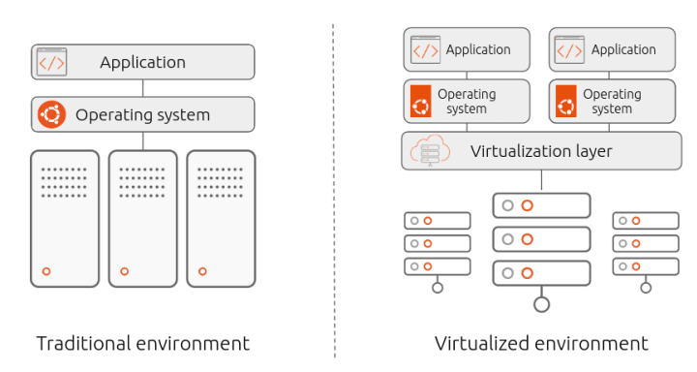
Traditional and Virtualized Environment

Slide 4
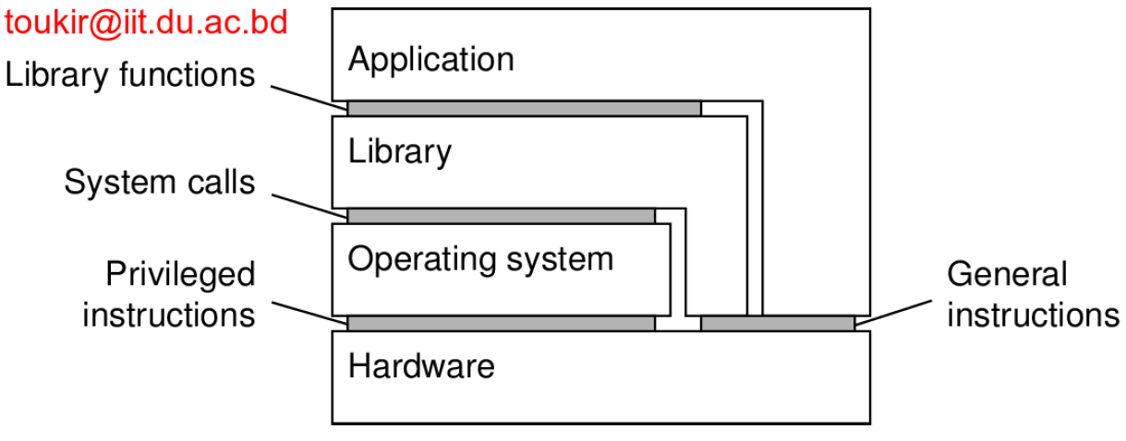
Virtualization
Four different types of interfaces, at four different levels:
An interface between the hardware and software, consisting of machine instructions that can be invoked by any program.
An interface between the hardware and software, consisting of machine instructions that can be invoked only by privileged programs, such as an operating system.
An interface consisting of system calls as offered by an operating system.
An interface consisting of library calls, generally forming what is known as an application programming interface (API).

Slide 5
Virtualization
Virtualization is a process of creating an abstraction layer over hardware, allowing a single computer to be divided into multiple virtual computers.
Each of those virtual computers (known as “guests”) uses part of the hardware resources of the main computer (known as a “host”).
The software used to achieve this is a hypervisor. Hypervisors run on a host operating system and enable multiple guest operating systems to run on top of it, sharing the same physical computing resources managed by the host operating system.

Slide 6
Virtualization
Virtualization is important:
Hardware changes faster than software
Ease of portability and code migration
Isolation of failing or attacked components

Slide 7
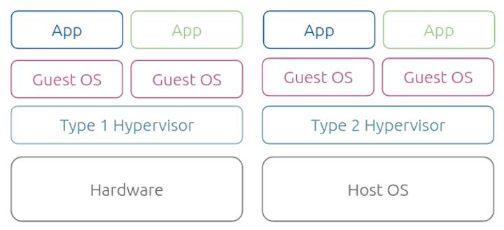
The role of a Hypervisor
Virtualization wouldn’t be possible without a hypervisor (also known as a virtual machine monitor) – a software layer enabling multiple operating systems to co-exist while sharing the resources of a single hardware host.
The hypervisor acts as an intermediary between virtual machines and the underlying hardware, allocating host resources such as memory, CPU, and storage.

Slide 8
The role of a hypervisor
Type 1 hypervisors, also known as bare-metal hypervisors, run directly on the host’s hardware and are responsible for managing the hardware resources and running the virtual machines.
Examples of Type 1 hypervisors include VMware ESXi, Microsoft Hyper-V, and Citrix XenServer.
Type 2 hypervisors, also known as hosted hypervisors, run on top of a host operating system and rely on it to provide the necessary hardware resources and support.
Examples of Type 2 hypervisors include VMware Workstation and Oracle VirtualBox.

Slide 9
Types of Virtualization
Server Virtualization
Storage Virtualization
Network Virtualization
Application Virtualization

Slide 10
Containers
A container can be thought of a collection of binaries (also called images) that jointly constitute the software environment for running applications.
A container is a lightweight alternative to full machine virtualization, which involves encapsulating an application in an isolated operating environment, with all the files and libraries it needs to operate.
Every containerized application can share the host system’s user space, while still maintaining its individual system processes, environment variables, and libraries.

Slide 11
What is containerization?
Containerization also allows users to run many instances on a single physical host, but it does so without needing the hypervisor to act as an intermediary.
Instead, the functionality of the host system kernel is used to isolate multiple independent instances (containers).
By sharing the host kernel and operating system, containers avoid the overhead of virtualization, as there’s no need to provide a separate virtual kernel and OS for each instance.

Slide 12
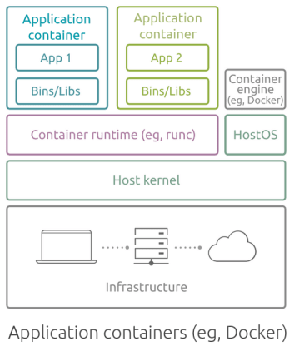
Application Containers
Application containers (such as Docker), also known as process containers, package and run a single process or a service per container.
They are packaged along with all the libraries, dependencies, and configuration files they need, allowing them to be run consistently across different environments.

Slide 13
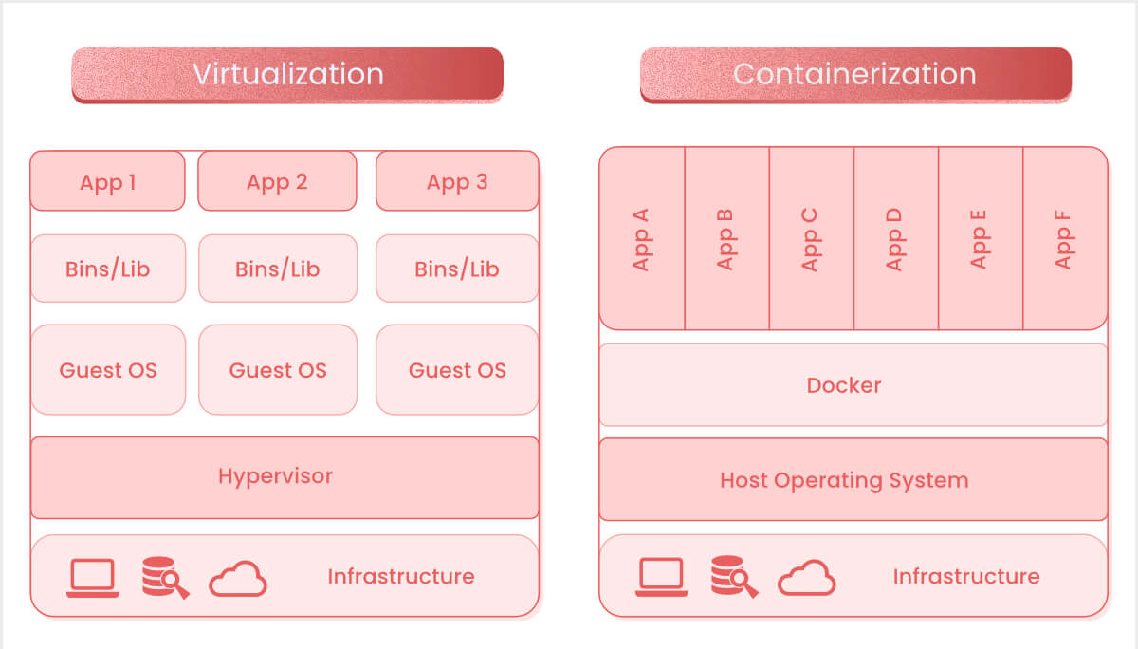
Containerization vs. Virtualization
Virtualization and containerization are the two most frequently used mechanisms to host applications in a computer system.

Slide 14
Containerization vs. Virtualization
Resource Overhead
When comparing containerization vs virtualization in terms of resource overhead, containerization is the clear winner.
Because containers share the host system’s operating system, and do not need to run a full operating system, they are significantly more lightweight and consume fewer resources.
Virtual machines, on the other hand, each require their own OS, which increases the overhead.

Slide 15
Containerization vs. Virtualization
Startup Time
In general, containers start up more quickly than VMs, because they don’t have to start up an entire operating system.
Virtual machines take much longer to boot up.
This means containers are more flexible and can be torn down and restarted whenever needed, supporting immutability, which means that a resource never changes after being deployed.

Slide 16
Containerization vs. Virtualization
Portability
Both containers and virtual machines offer a high degree of portability.
However, containers have a slight edge because they package the application and all of its dependencies together into a single unit, which can be run on any system that supports the container platform.
Virtual machines, while also portable, are more dependent on the underlying hardware.

Slide 17
Containerization vs. Virtualization
Security Isolation
In terms of security isolation, virtual machines have the advantage.
Because each VM is completely isolated from the host system and other VMs, a security breach in one VM typically does not affect the others (although it is possible to compromise the hypervisor and take control of all VMs on the device).
Containers, while isolated from each other, still share the host system’s OS, so a breach in one container could possibly leak to other containers.

Slide 18
Containerization vs. Virtualization
Scalability and Management
The lightweight nature and rapid startup time offered by containers make them ideal for scaling applications quickly and efficiently.
They also lend themselves well to the microservices architecture, which can simplify the management of complex applications.
Virtual machines, while also scalable, are more resource-intensive and take longer to start, making them less suitable for microservices and distributed applications.

Slide 19
Use Cases for Virtualization
Legacy Applications
Environments Needing Strong Isolation
IaaS Scenarios

Slide 20
Use Cases for Containerization
Microservices Architectures
CI/CD
PaaS Scenarios

